Slide 1
Interactive GUI

Slide 2

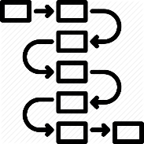

Interactive GUI Architecture
Interactive GUI
User domain knowledge input
Feature selection
Weighting
User friendly
類似線上點餐
Pipeline
Result (Report)
Preprocess
Feature engineering
Model
Parameter search
Model KPIs
Dashboard

Slide 3
GUI Demo

Slide 4
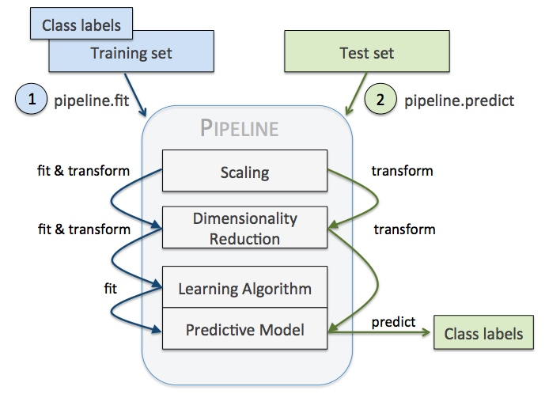
Pipeline 簡介
減少重複程式碼量
讓機器學習的流程變得直觀

Slide 5


Pipeline 實例
As-is
To-be
tmpX = X1[col].rolling(window=4)\
.agg(['sum','std','mean'])
trainX = pd.merge(X, tmpX, on='date')
pca = PCA(n_components=1)
pca_X = pca.fit_transform(trainX)
XGB = XGBRegressor(n_estimators=100)
XGB.fit(pca_X)
tmpX = X2[col].rolling(window=4)\
.agg(['sum','std','mean'])
testX = pd.merge(X, tmpX, on='date')
pca_X = pca.fit_transform(testX)
pred_y = XGB.predict(pca_X)
mean_squared_error(test_y, prd_y)
pipe = Pipeline([
('Rolling', RollingWindow() ),
('PCA', PCA() )
('XGB', XGBRegressor() ),
])
param = {
'Rolling__window': [4, 5, 6],
'XGB__n_estimators': [100, 200, 300]
}
clf = GridSearchCV(pipe, param)
clf.fit(X, y)
不只流程清楚，
連各種參數組合都幫你試了，
真是太棒了！
只做了一組參數

Slide 6
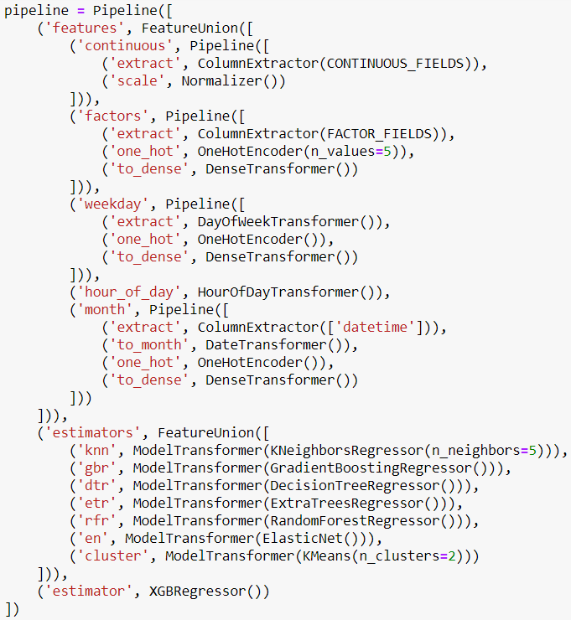
複雜Pipline
產生各種feature
2-level Stacking

